Slide 1
Airport Flight Database
Flight Information Display System (F.I.D.S.).
By Benton, Luke, and PJ
Notes:
Airport Flight Database

Slide 2
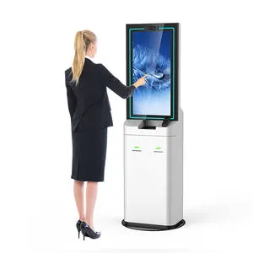
Background and motivations
We are making an airport flight tracker and passenger check in database
We wanted to make something similar to a airport arrivals and departures kiosk
Company Name
Quarter Month
Year

Slide 3
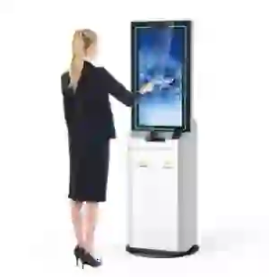
Who are target users?
Passengers, airport staff, potentially pilots, TSA

Slide 4

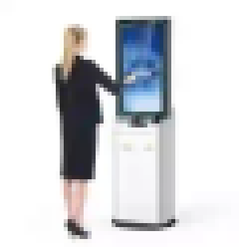
(Context)
Context
It is 1 a.m. on a monday morn. You have an important work meeting four states over & the only way to make it on time is to take a 6½ hour flight to get there thirty minutes before to give your boss a cup of coffee that they’ll take one sip of before forgetting about it. By a stroke of luck, you were able to book a last minute flight, & arrive at the airport on time & manage to get through security without a hassle. You sit on down near the terminal and shut your eyes for a moment’s respite.
But alas, respite would not last.
You snap awake, in a panicked frenzy after hearing the airport P.A. announce your flight was moved to a different terminal. You look at the clock on your ankle monitor and realize your flight is exactly 67.67 seconds away from closing and beginning departure.
Like a hypebeast, you rise from torpor and break into a feral sprint across the airport vigilantly hunting your flight’s terminal. Time is of the essence as you run and run and run. Then, like a flickering flame in darkness, you see it.
A 65” by 55” monitor kiosk displaying the flight information display system (F.I.D.S.). Like a moth drawn to the flame, you skedaddle as fast as your overworked legs can take you. A single tear rolls down your eye as you witness your flights new terminal.
Forrest Gumping, you reach your plane and slide underneath the closing door as you reach your seat on the plane and close your eyes. You will make it to that meeting. All thanks to that FIDS
Notes:
TLDR: flight information display system (F.I.D.S.) is pretty cool & efficient for helping people get to where they need to go.

Slide 5

What websites will use this?
Official airlines, ticket buying websites,
in airport kiosques, and the CIA
\
Notes:
Kill tarantino

Slide 6

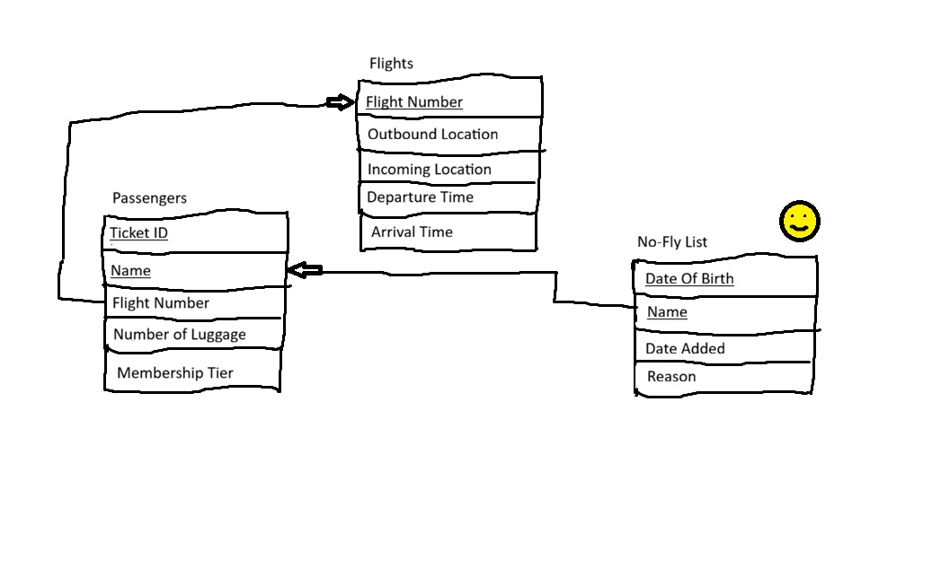
Sketch

Slide 7

Task Distribution
Luke - Front end dev
Benton - Back end dev
P.J. - Both + Documentation

Slide 8
END
Or is it?
Year
Notes:
END

